Slide 1
Group 11 Disease Solutions
Michael Wang, Julia Monti, Karuna Srivastava,
Richard Amayo, Mrunmayi Dandekar

Slide 2
Agenda
Project Overview
Methodology
Solution
Conclusion

Slide 3
Project Overview

Slide 4
Objectives
Create an automated process that simulates multiple disease spreads throughout population of West Lafayette and Lafayette
1
Aid public policy officials in devising flexible and effective policy strategies to mitigate the spread of pandemic diseases
2
Determine the costs associated with choices regarding implementing policy strategies
3

Slide 5
Methodology

Slide 6
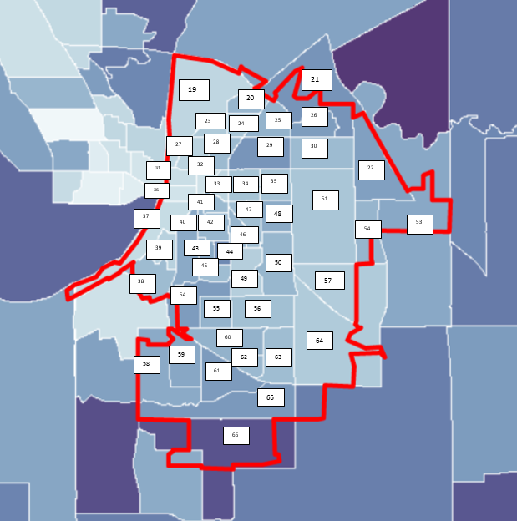
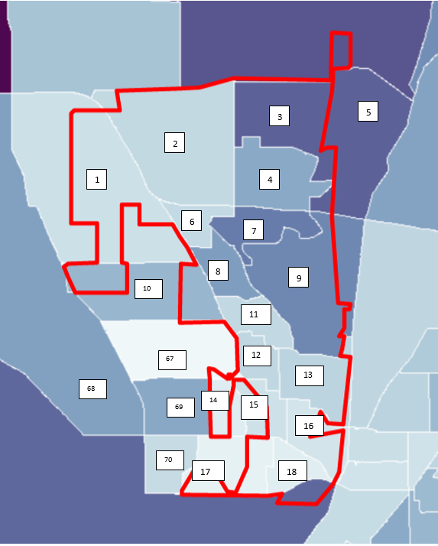
Population Simulation
Based on regional definitions

Slide 7
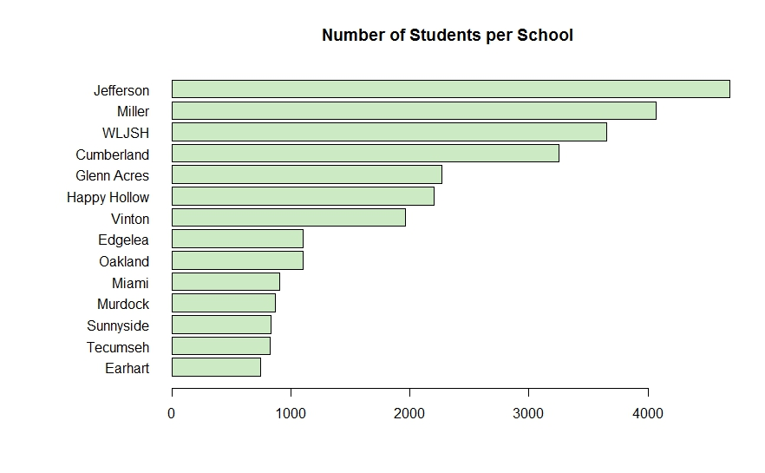
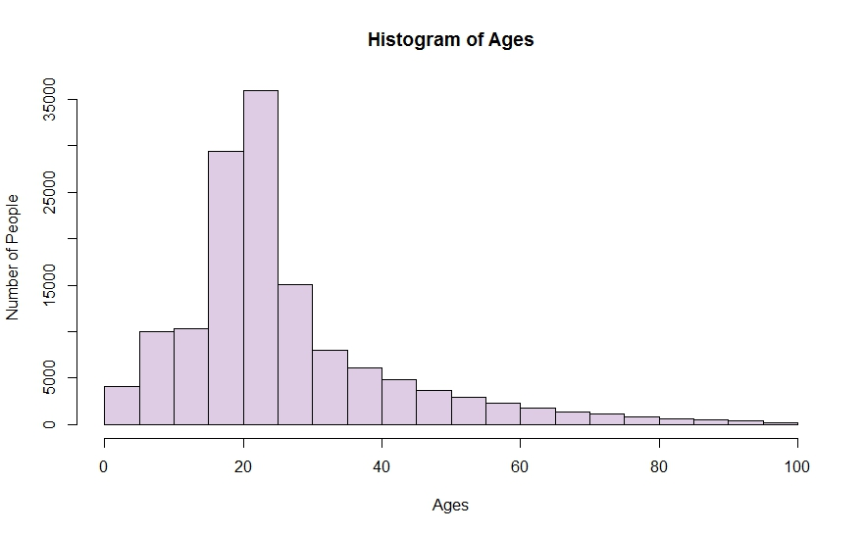
Population Simulation
Statistics on Individuals:
Date of Birth
Sex
Workplace
School

Slide 8
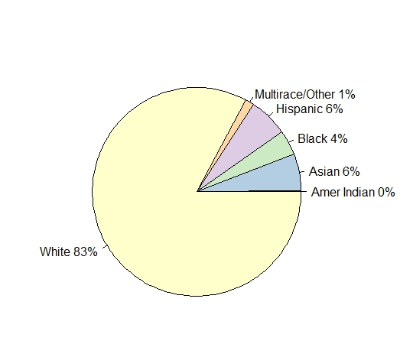
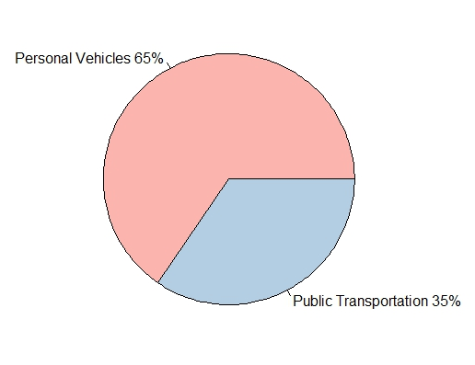
Population Simulation
Statistics on Households:
Race
Public Transportation Usage
Household Income

Slide 9
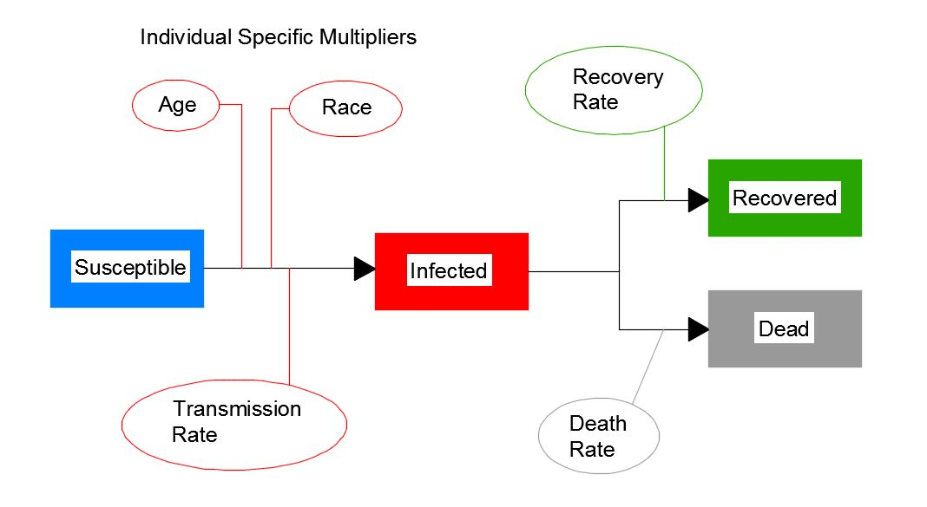
Disease Spread Model

Slide 10
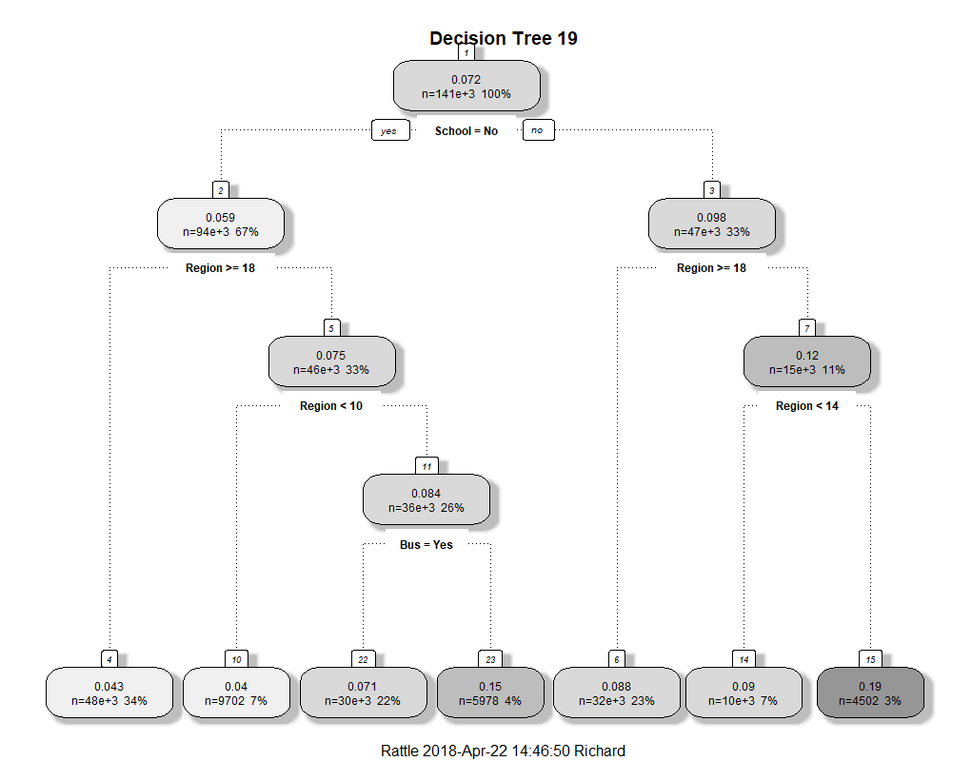
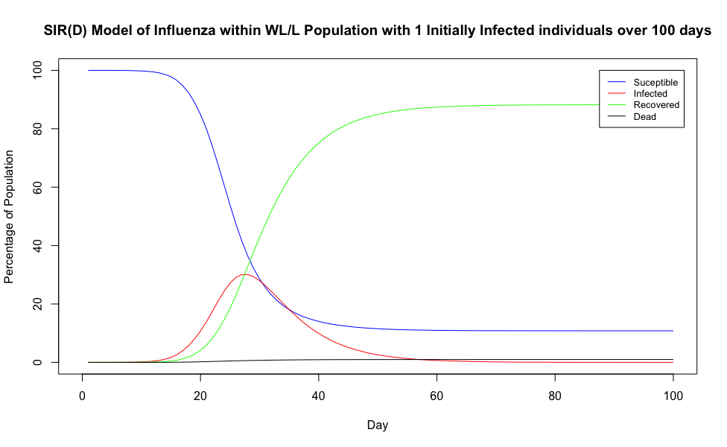
Intelligent Decision Making
Notes:
This is where we can VERY BRIEFLY mention that the results of the disease spread were analyzed (using machine learning) to identify common factors to target with intelligent policy responses to mitigate disease spread

Slide 11
Solution

Slide 12
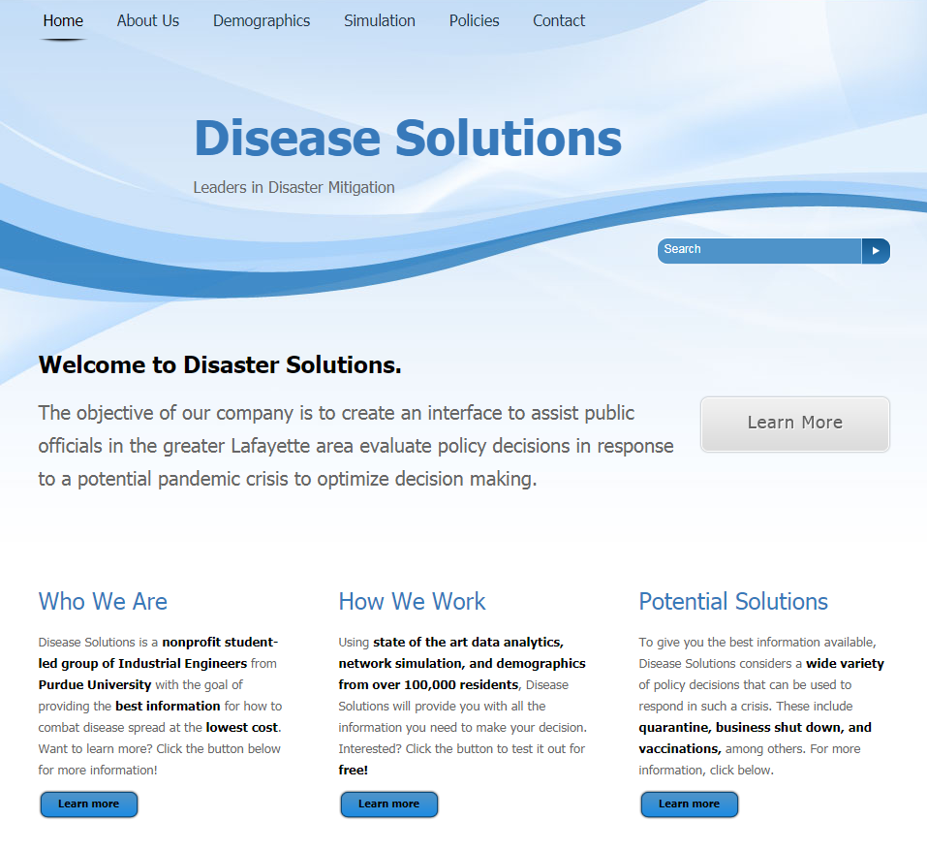
Interactive Website Interface
Features of Note:
Dynamic Demographic Descriptions
Disease Spread Simulation
Policy Recommendations and Cost Analysis

Slide 13
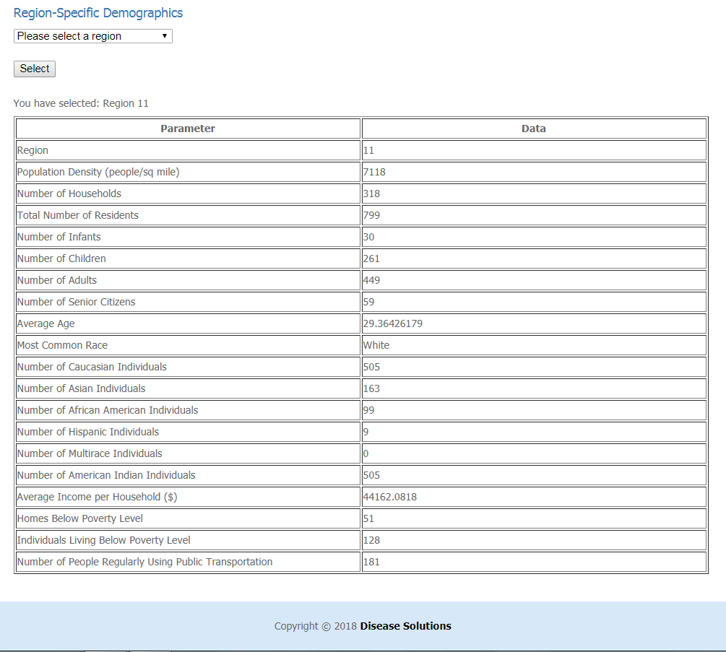
Dynamic Demographic Descriptions
Region-Specific Information:
Count of Households and Individuals
Classification of Infants, Children, Adults, and Senior Citizens
Race Distributions
Income and Poverty Breakdown

Slide 14
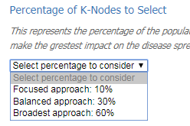
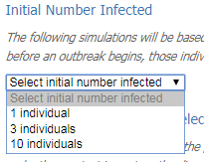
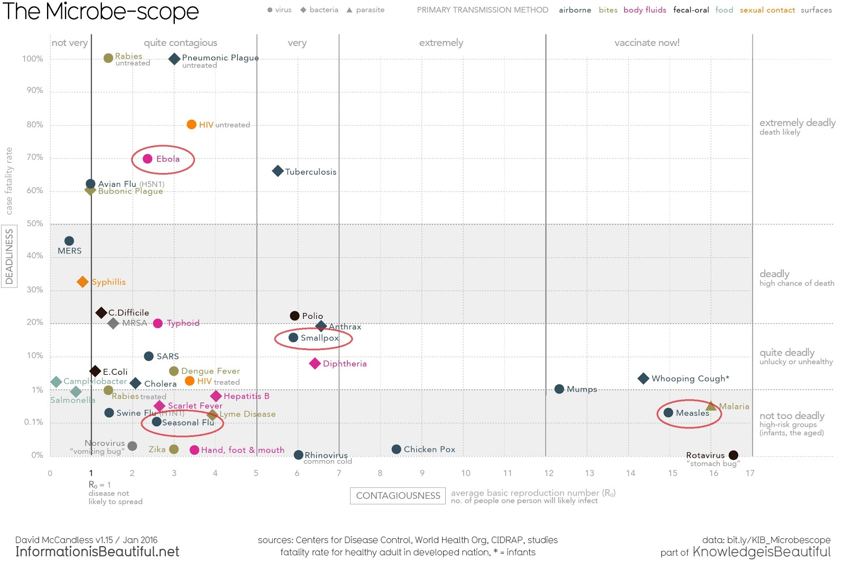
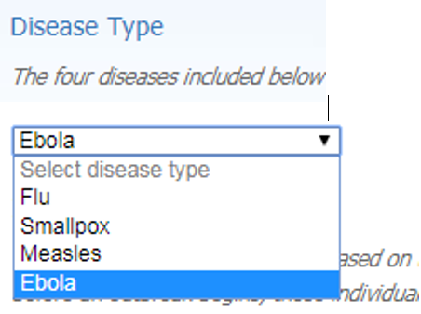
Simulation Inputs

Slide 15
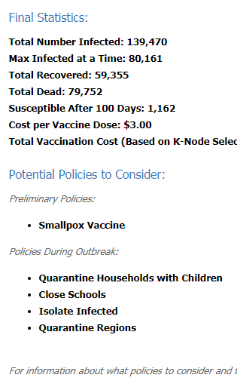
Disease Spread Simulation
Important Features
Standardized recognizable diseases for ease of use
Multiple initial infection options to represent difficulty in initial containment
Varying policy focus to factor into cost analysis

Slide 16
Disease Spread Simulation Results
Important Features
Standardized recognizable diseases for ease of use
Multiple initial infection options to represent difficulty in initial containment
Varying policy focus to factor into cost analysis

Slide 17
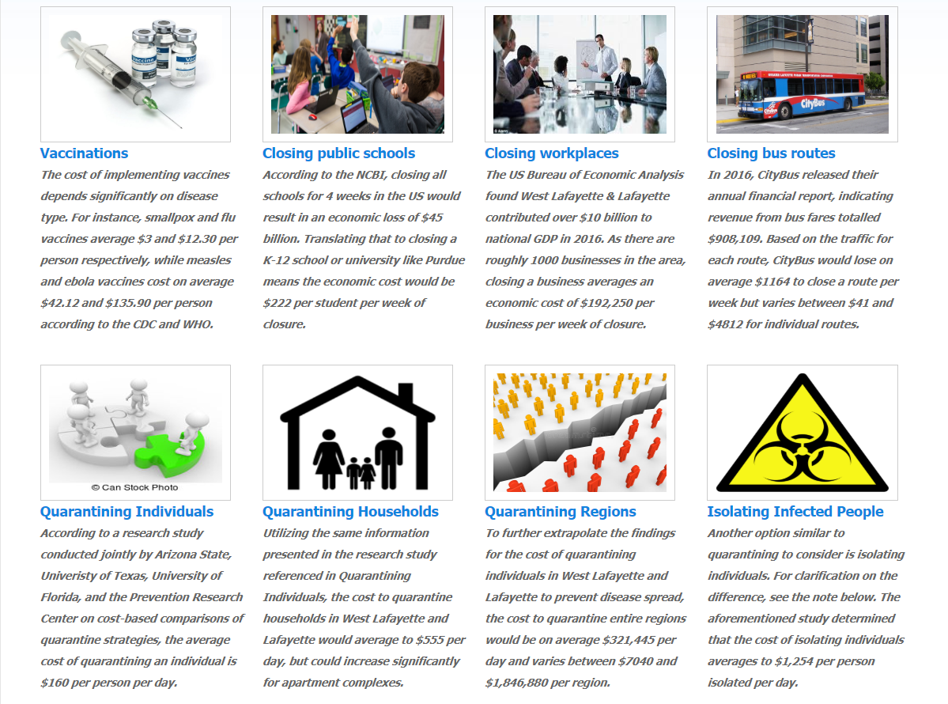
Policy Cost Analysis
Policy Name | Average Costs
Flu Vaccine | $12.30/treatment
Smallpox Vaccine | $3.00/treatment
Measles Vaccine | $42.12/treatment
Ebola Vaccine | $135.90/treatment
Closing Public Schools | $222/student/ week
Closing Workplaces | $192,250/ business/week
Closing Bus Routes | $1164/route/week
Quarantine Individuals | $160/person/day
Quarantine Households | $555/household/day
Quarantine Regions | $321,445/region/day
Isolating Infected People | $1,254/person/day

Slide 18
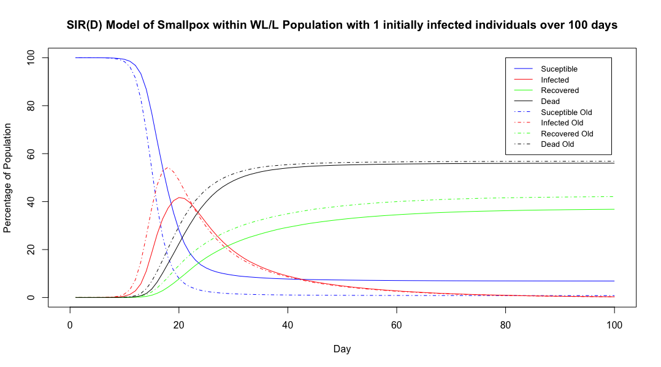
Policy Impact
Implemented vaccination policy
Saves 20,000 lives
Prevents 40,000 infections

Slide 19
Conclusion

Slide 20
Conclusion
The West Lafayette and Lafayette area is in need of a technological solution to aid policymakers in preparing for potential pandemic outbreaks
This solution meets that need by
Simulating multiple disease spreads through the area
Determining flexible and effective policies to mitigate disease impact
Calculates the costs associated with implementing policies

